Slide 1


DataBase Logic in Business Applications
Al.I. Cuza University of Iași
Faculty of Economics and Business Administration
Department of Accounting, Information Systems
and Statistics
Triggers – part I
Introduction. Triggers & sequences
By Marin Fotache & Co.

Slide 2
Tutorials on PL/SQL Triggers
Database Triggers Overview
https://oracle-base.com/articles/misc/database-triggers-overview
Database PL/SQL Language Reference (2021)
https://docs.oracle.com/en/database/oracle/oracle-database/19/lnpls/plsql-triggers.html#GUID-217E8B13-29EF-45F3-8D0F-2384F9F1D231
Triggers In PL SQL: Tutorial With Example Programs (2021)
https://www.softwaretestinghelp.com/triggers-in-pl-sql/
Triggers : Trigger « Trigger « Oracle PL/SQL Tutorial http://www.java2s.com/Tutorial/Oracle/0560__Trigger/Triggers.htm
Triggers in PL/SQL
https://www.guru99.com/triggers-pl-sql.html
PL/SQL Triggers
http://www.way2tutorial.com/plsql/plsql_triggers.php

Slide 3
Text (in Romanian)
https://github.com/marinfotache/Database-Logic-in-Business-Applications/tree/master/Oracle%209i2.%20Ghidul%20dezvoltarii%20aplicatiilor%202003/Cap11_Declansatoare
https://github.com/marinfotache/Baze-de-date-I/blob/master/SQL.%20Dialecte%20DB2-%20Oracle-%20PostgreSQL%20si%20SQL%20Server/SQL2009_Cap17_Declansatoare.pdf
(sections 17.1 and 17.3)

Slide 4
Agenda
Sequences – brief description
Sequence creation (CREATE SEQUENCE), altering (ALTER SEQUENCE), calling (NextVal, CurrVal)
Triggers taxonomy
DML trigger types
DDL and system trigger types
Main applications of triggers
BEFORE INSERT ... FOR EACH ROW triggers (getting a surrogate key values from a sequence)
Triggers for foreign key management (UPDATE... CASCADE)

Slide 5
Sequences
Database objects that generate unique values based on some basic parameters (start value, end value, increment, order, cache)
Public (as the tables are)
Generated value cannot be "rollbacked" (not subject of transactions)
Ideal for surrogate keys
Work best with (insert triggers)
Basic example:
CREATE SEQUENCE a_sequence START WITH 1001 MINVALUE 1 MAXVALUE 9999999 INCREMENT BY 1 NOCACHE NOCYCLE

Slide 6
Sequence Main Parameters
MINVALUE (the smallest value a sequence may generate)
START WITH value (first value generated by the sequence) - could be identical to MINVALUE, but not necessarily
MAXVALUE (the largest value a sequence may generate)
INCREMENT BY (step, i.e. the increment amount)
CYCLE: declares if, after the max value is reached, at the next sequence call (NextValue) an error will be generated (NOCYCLE) or the sequence restarts with MINVALUE
ORDER – generated values will be ordered or not
CACHE – we will use mostly NOCACHE (we need this for controlling the sequence values within triggers)

Slide 7
Altering the Sequence
Once created, some sequence parameters may be modified `on-the-fly` using ALTER SEQUENCE:
step (INCREMENT BY)
MAXVALUE
CYCLE
... But, if we want to "jump" the sequence current value (.CurrVal) to the MINVALUE,
First, one must delete the sequence (DROP SEQUENCE)
... And then re-create it (CREATE SEQUENCE)

Slide 8
Sequence Calling (Invoking)
When calling a sequence (from a PL/SQL block), we may use two main properties (called pseudo-columns):
NEXTVAL
CURRVAL
NEXTVAL:
Extracts the next value generated by the sequence
Usually with NEXTVAL we set the value of a surrogate key in a BEFORE INSERT ... FOR EACH ROW trigger of the table the surrogate key belongs to
Cannot be ROLLED BACK!!!! (if NextVal appears in a transaction that is cancelled (through ROLLBACK), the sequence value is `lost`
CURRVAL:
Returns (provides) the most recent (last) value generated by the sequence (trough NEXTVAL)
For each session, before initial call of CURRVAL, the sequence must be initiated with a NEXTVAL clause
If we need to know the last generated sequence value without `spending` a value we cal use USER_TRANSACTIONS view in the data dictionary (pay attention to CACHE parameter!)

Slide 9
Triggers
Represents the core of a database logic layer within a business application
Triggers are PL/SQL modules that are launched automatically at a specific pre-defined event
Type of events that can be associated with a trigger:
Starting the database
Shutting down the database
Login to the database server
Logout from the database server
A DDL statement (CREATE TABLE, DROP VIEW, ...)
A DML statement (INSERT/UPDATE/DELETE)
Occurence of an error within a database server

Slide 10
Some Trigger Applications
Surrogate key handling
CASCADE UPDATEs - when one or more values of the primary key are updated (in the parent table) they must be propagated into all the children tables
Computed (derived, redundant) attributes management, through automatic updates (see Invoice_Amount, Account_Current_Balance, etc.)
Implementing complex constraints
Preventing unauthorized access and updates to the computed attributes and/or any other sensitive information
Declaring/implementing complex business rules
Logging of sensitive transactions

Slide 11
Trigger Events (1)
Database Level Events
Database startup (STARTUP)
Database stop (SHUTDOWN)
User session
LOGON
LOGOFF
DDL statement execution (launch)
CREATE
DROP
ALTER
Occurence of a database server error (SERVERERROR)

Slide 12
Trigger Events (2)
Table events:
Add one or more records into a table (INSERT)
Update one or more records in a table (UPDATE)
Delete one or more records in a table (DELETE)
View events – INSTEAD OF
Add one or more records into a view (INSTEAD OF INSERT)
Update one or more records in a table (INSTEAD OF UPDATE)
Delete one or more records in a view (INSTEAD OF DELETE)

Slide 13
Trigger `Moment` (Timing)
BEFORE triggers
Executed (lauched) before checking the table constrains (PRIMARY KEY, UNIQUE, CHECK, FOREIGN KEY)
Operation (INSERT/UPDATE/DELETE) results cannot be seen/read in the BEFORE triggers
AFTER triggers
Executed after checking the table constrains (PRIMARY KEY, UNIQUE, CHECK, FOREIGN KEY)
Operation (INSERT/UPDATE/DELETE) results can be seen/read in the AFTER triggers

Slide 14
(DML) Triggel Levels
Statement level triggers:
Default (no clause required)
Trigger statement is executed just once BEFORE or AFTER a DML statement (INSERT/UPDATE/DELETE) is performed, no matter how many record will be affected by the DML statement (e.g. how many records will be deleted by the DELETE statement)
Row level triggers:
Require FOR EACH ROW clause in the syntax
Are executed for each row affected by the DML command (each inserted, updated or deleted record/row)
Could also be defined as BEFORE or AFTER triggers
We can acces the attribute values before the statement execution (:OLD) and also the attribute values after the statement execution (:NEW)
We can alter (overwrite) an attribute value resulted from a DML statement using triggers of type BEFORE - ROW

Slide 15
More Recent Trigger Features
Before Oracle 11g, for a certain event we could define two or more triggers (e.g. two triggers of type BEFORE – INSERT – ROW for the same table), but we were not able to control the order of the triggers execution
After Oracle 11g version, the triggers can be executed in a specific order using FOLLOWS/PRECEDES clause
This feature is necesary when our application is pre-configured with a set of triggers we are not allowed to alter, and, in order to implement additional business rules, it is necessary to add new triggers to the existing ones
Also starting with Oracle 11g COMPOUND triggers are available
That could improve code lisibility and reduce the number of lines of code required by the triggers

Slide 16
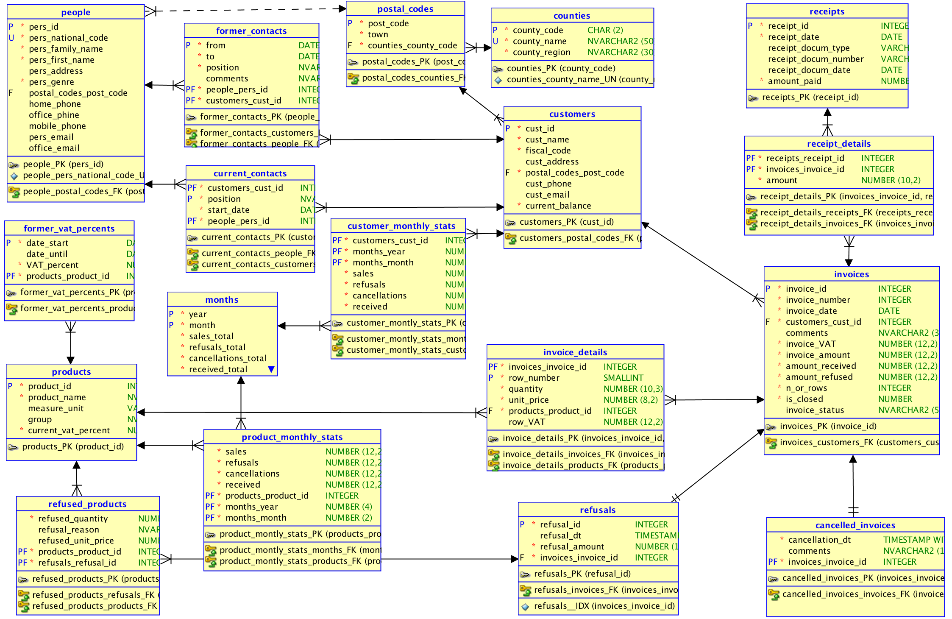
sales database schema (relational)

Slide 17
Scripts on GitHub
See section 06_Triggers/ of the course:
https://github.com/marinfotache/Database-Logic-in-Business-Applications/tree/master/06_Triggers
Prerequisites (for setting up the database)
06-00-2_fixed_DDL_script_sales_2015.sql
06-00-3_add_constraints_sales_2015.sql
Scripts related to this presentation:
06-01a_en_sequences.sql
06-01b_en_data_cleaning__surrogate_keys.sql
06-01c_en_cascade_updates.sql

Slide 18
Surrogate Keys

Slide 19
Script 06-01a_en_sequences.sql
Sequence creation and methods
CREATE SEQUENCE
NextVal and CurrVal methods
Sequences in the data dictionary (USER_SEQUENCES)
06-00-3_add_constraints_sales_2015.sql
Using sequences in INSERT commands
Creating sequences for database surrogate keys:
seq__cust_id
seq__pers_id
seq__invoice_id
seq__product_id
seq__receipt_id
seq__refusal_id

Slide 20
Script 06-01b_en_data_cleaning__surrogate_keys.sql
Simple triggers
before/after row level
before/after statement level
Triggers for data cleaning
Triggers and surrogate keys
Problems (and solutions) when dealing with surrogate keys
updates that set the surrogate key value above the current value of the corresponding sequence
managing foreign keys values of the surrogate keys when inserting records in child tables

Slide 21
Foreign Keys in sales Database

Slide 22
Script 06-01c_en_cascade_updates.sql
These triggers are needed since UPDATE CASCADE feature is not available in Oracle for CREATE/ALTER TABLE statement
Changes of counties.county_code values must be propagated into postal_codes.county_code
Changes of postal_codes.post_code values must be propagated into:
customers.post_code
people.post_code
Changes of customers.cust_id values must be propagated into:
invoices.cust_id
current_contacts.cust_id
customer_monthly_stats.cust_id
former_contacts.cust_id
Changes of months.year and/or months.month values must be propagated into:
customer_monthly_stats.year and customer_monthly_stats.month
product_monthly_stats.year and product_monthly_stats.month

Slide 23
Script 06-01c_en_cascade_updates.sql (cont.)
Changes of people. pers_id values must be propagated into:
current_contacts.pers_id
former_contacts.pers_id
Changes of products. product_id values must be propagated into:
invoice_details.product_id
former_vat_percents.product_id
product_monthly_stats.product_id
refused_products.product_id
Changes of invoices.invoice_id values must be propagated into:
invoice_details.invoice_id
cancelled_invoices.invoice_id
receipt_details.invoice_id
refusals.invoice_id
Changes of receipts.receipt_id values must be propagated into receipt_details.receipt_id
Changes of refusals.refusal_id values must be propagated into refused_products.refusal_id

